Slide 1
Capstone Project News Classification – Fake/Real

Slide 2
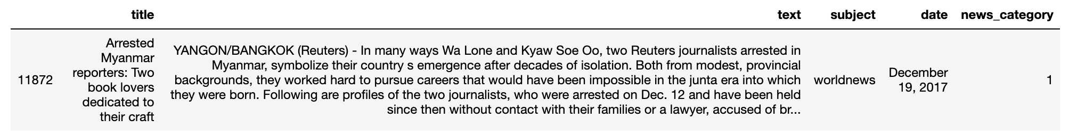
Purpose
Data Acquisition and Cleaning
Fake and real news dataset downloaded from Kaggle
Build a machine learning model that can classify news articles into real or fake
Contains 2 csv files, one containing 23,481 articles considered as fake news, the other containing 21,417 articles considered as for real news
Both the files were merged to form a single data frame. Target column named ‘news_category’ with values 0 for fake news and 1 to represent real news

Slide 3
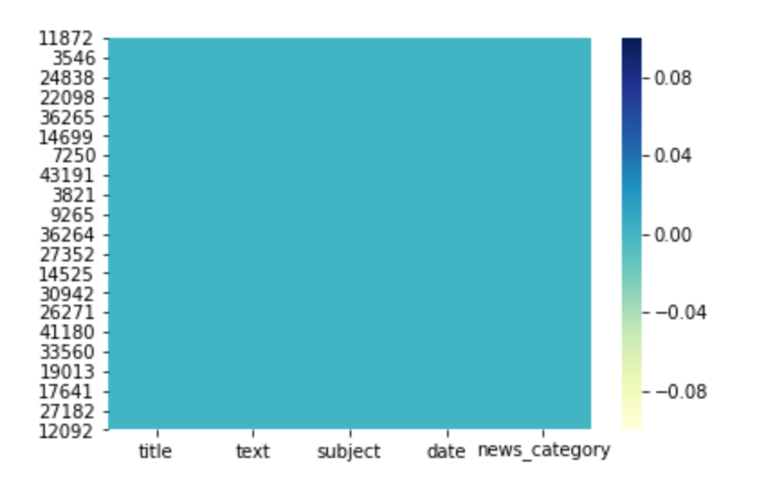
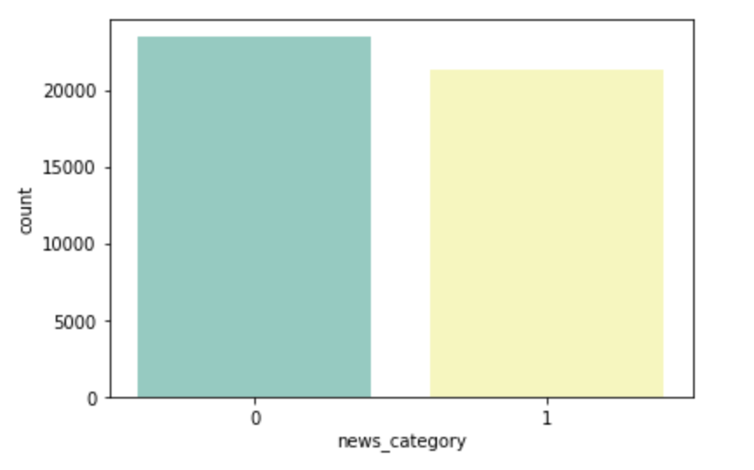
Data Analysis
23481 articles classified as fake and 21417 classified as real. Target classes are well balanced
Data has no null/missing values

Slide 4
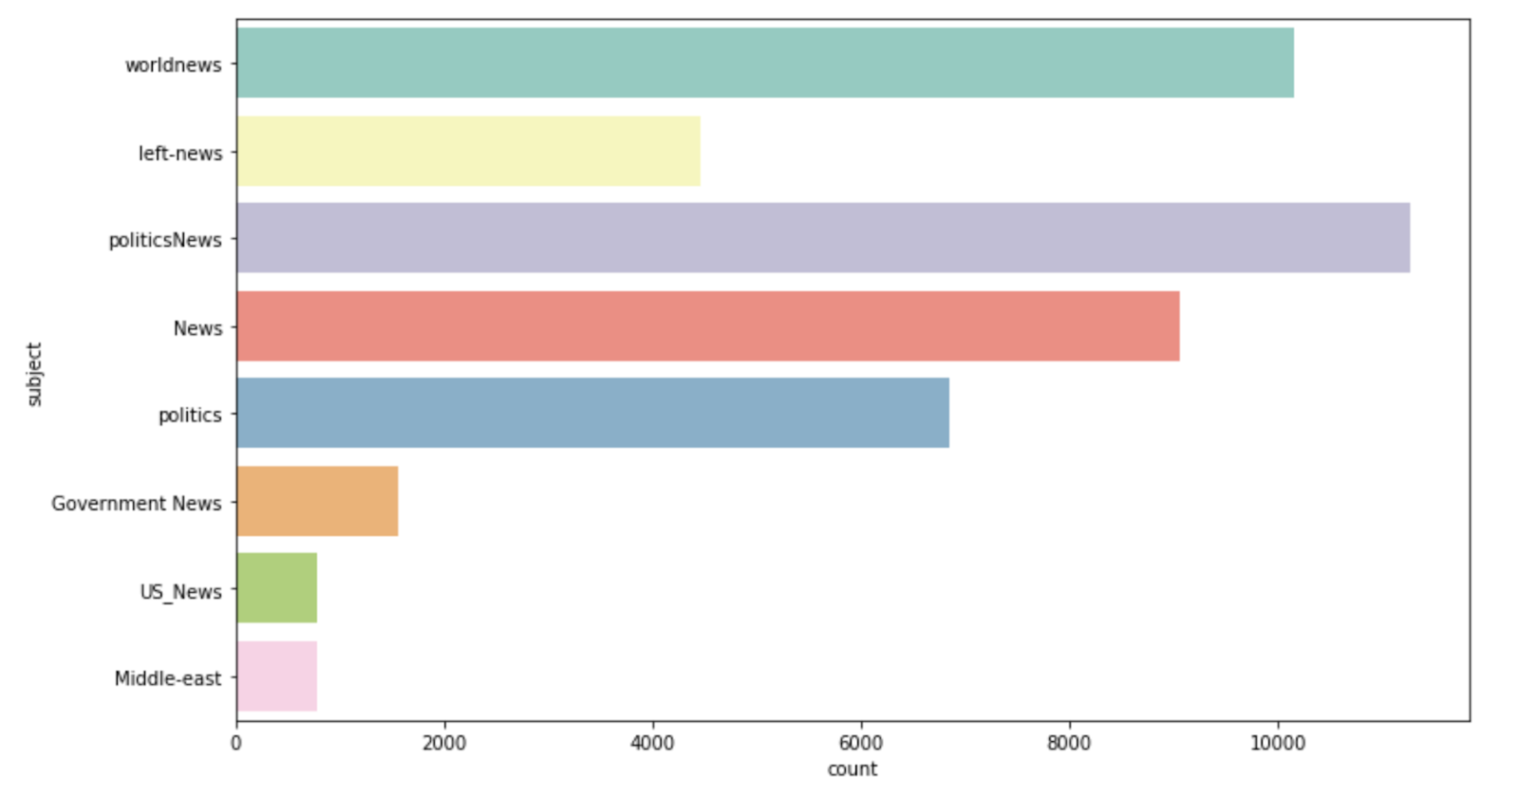
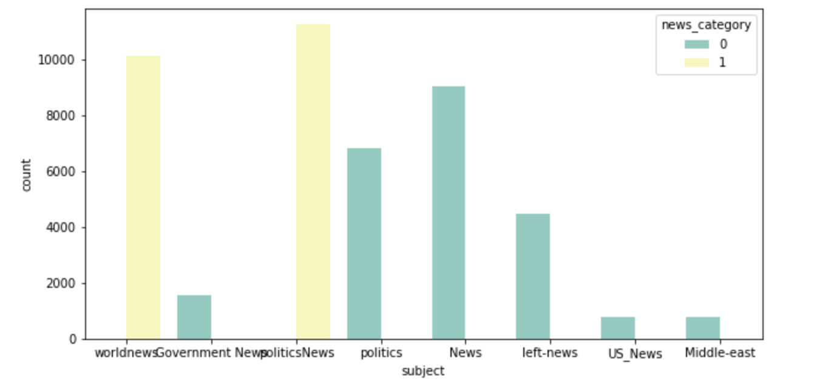
Most news articles are around politics and world news
Count of Subject Fake news vs Real news
The topics in the ‘subject’ column are different for real and fake news hence we will exclude it from the data

Slide 5
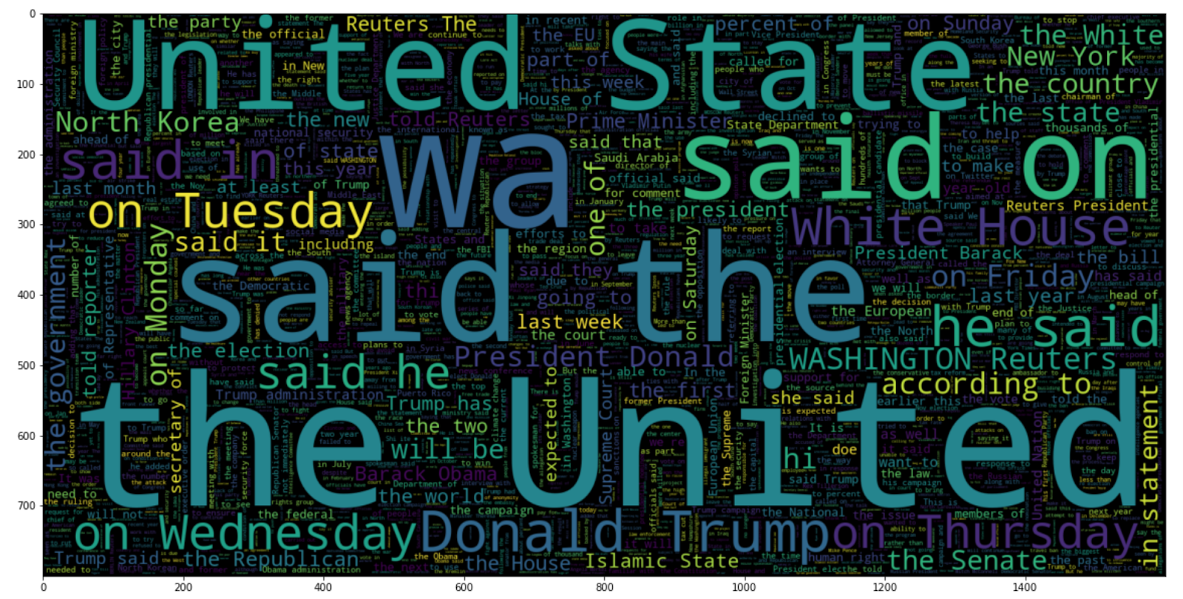
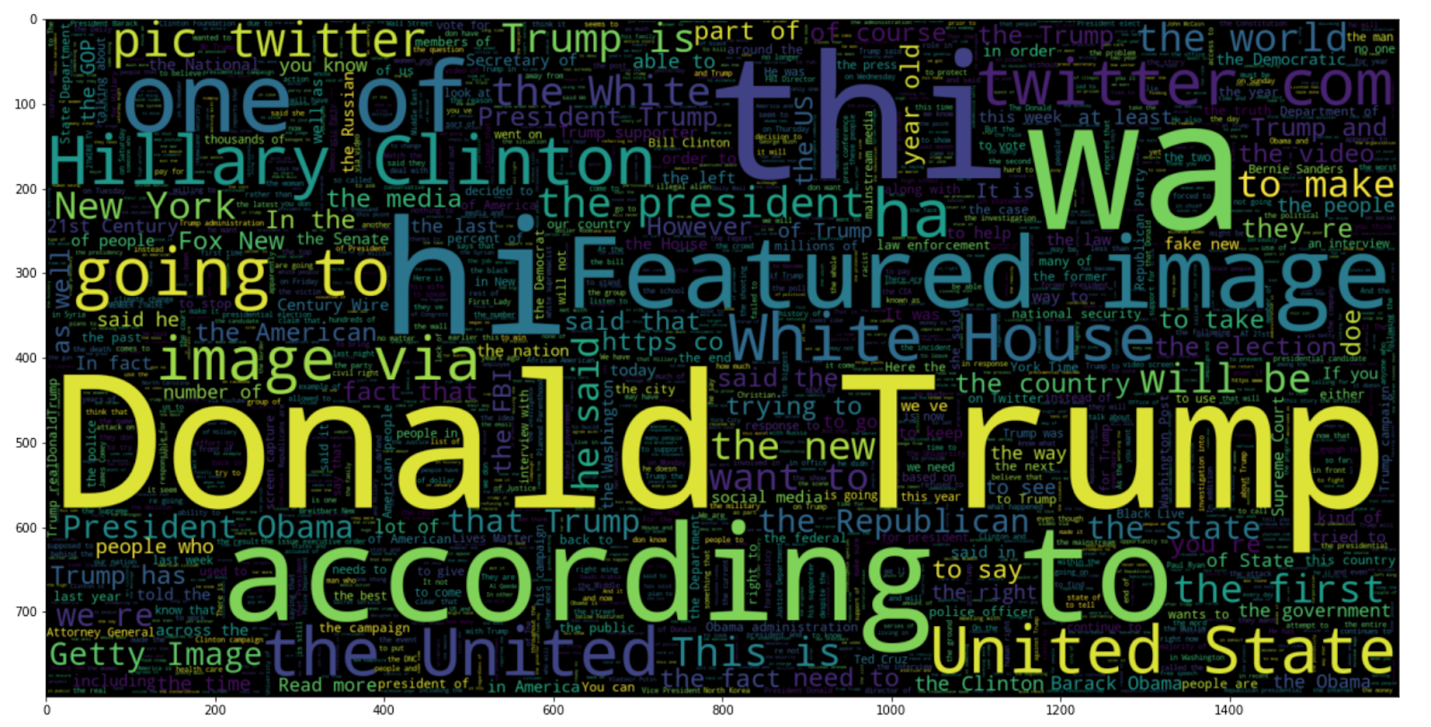
Word Cloud – Real News
Word Cloud – Fake News

Slide 6
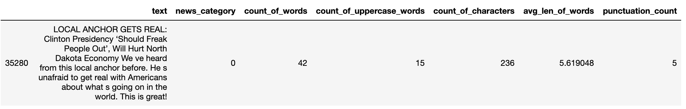
Feature Engineering
Following columns based on the ‘text’ column
'count_of_words' - total number of words in the article
‘count_of_uppercase_words’ - total number of upper count words in the articles
'count_of_characters' - total number of characters in the articles
'avg_len_of_words' - average length of the words used in the articles
'punctuation_count' - total number of punctuation marks in the articles
Frequency distribution of Part of Speech Tags:
Noun Count
Verb Count
Adjective Count
Adverb Count
Pronoun Count

Slide 7
Text processing
Case conversion - converted text to lowercase and removed accented characters
Expanded contractions (expand words such as I’d to I would) and removed special characters
Applied lemmatization to the text
Removed stop-words
Create n-gram (3-gram) level TF-IDF vectors as features and converted the TF-IDF scores of n-grams to data frame
Merged the TF-IDF data frame with the data frame containing the other columns
Dropped the ‘title’ column, now the dataset is ready for modeling

Slide 8
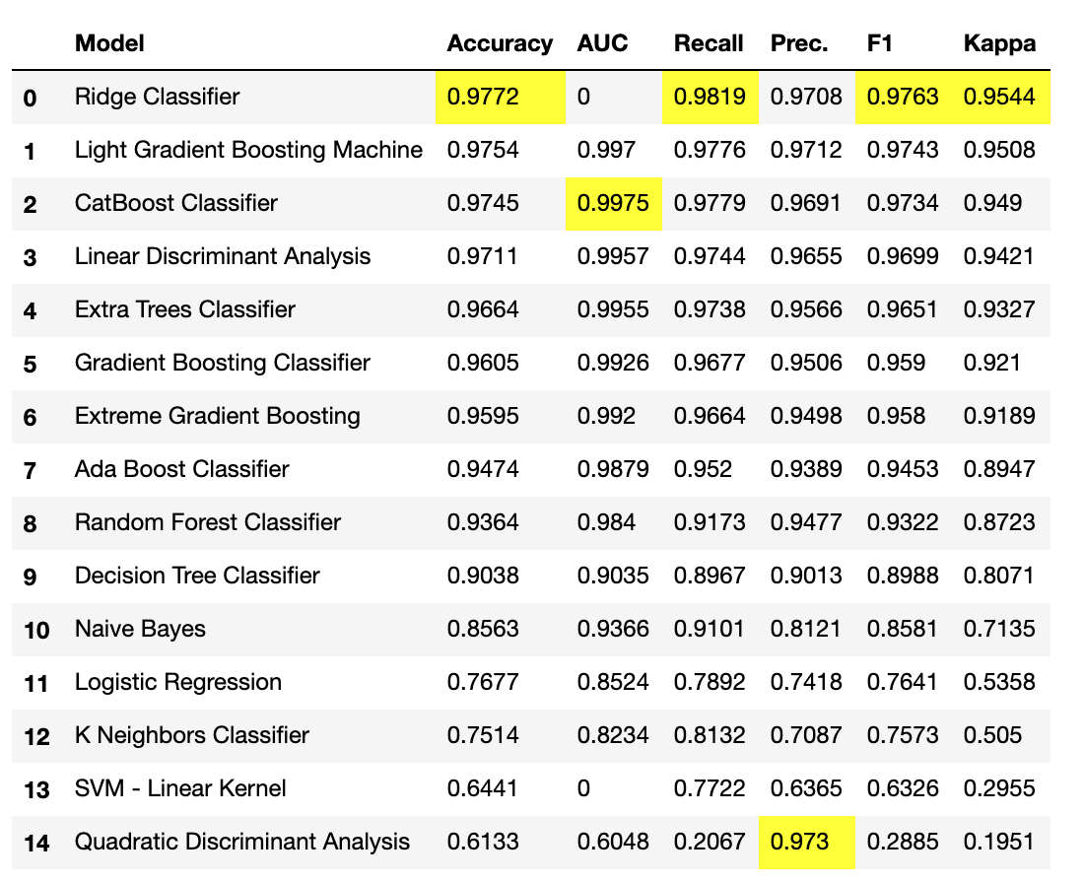
Data Modeling - Results
Ridge Classifier performs the best with accuracy of 97.72%

Slide 9
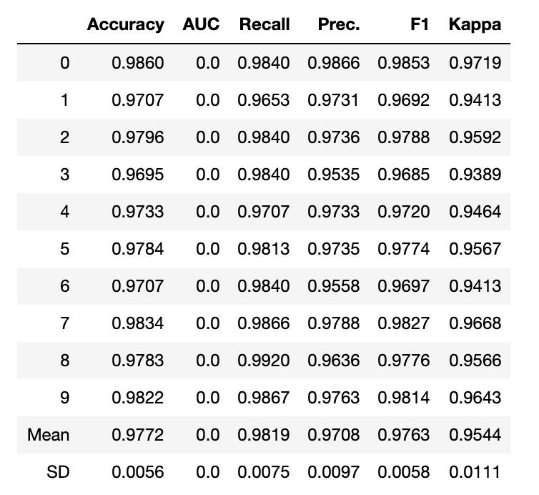
Ridge Classifier with 10-fold stratified cross validation

Slide 10
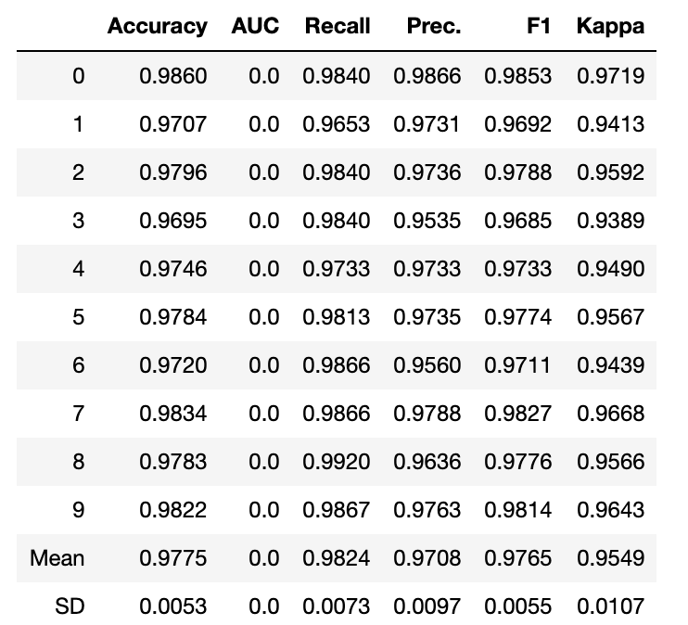
Hyperparameter tuning:
Hyperparameter tuning did not really improve the model much. Accuracy is 97.75%

Slide 11
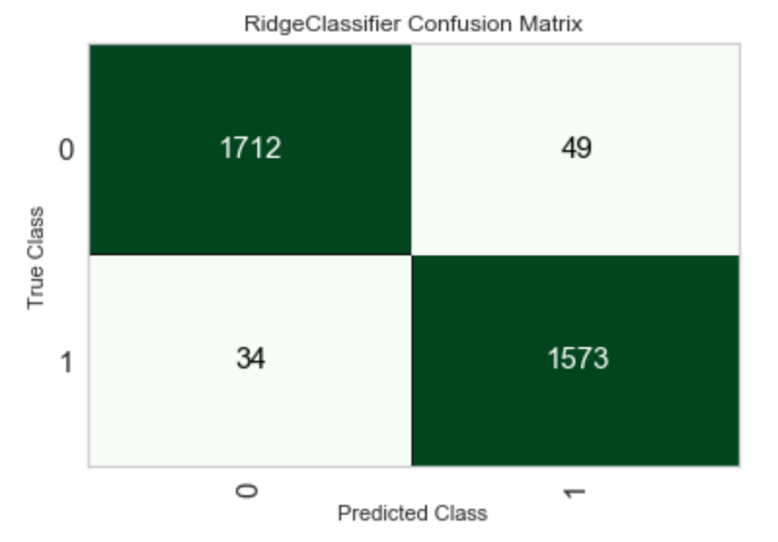
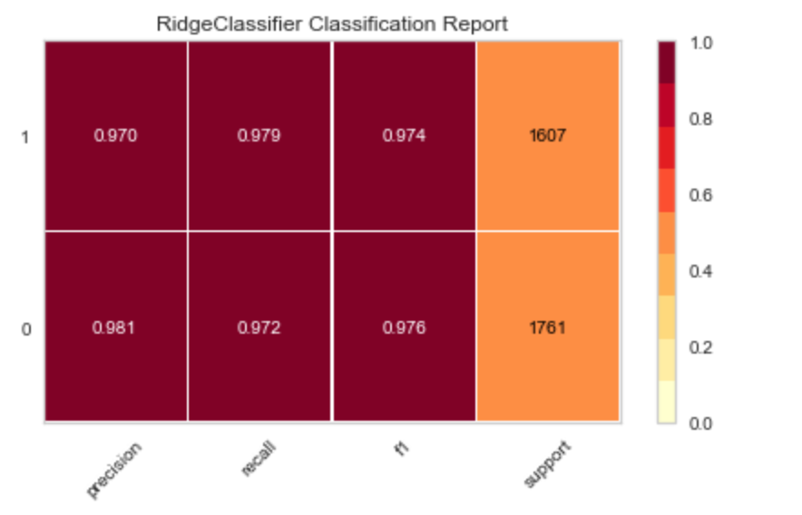
Results for Ridge Classifier

Slide 12
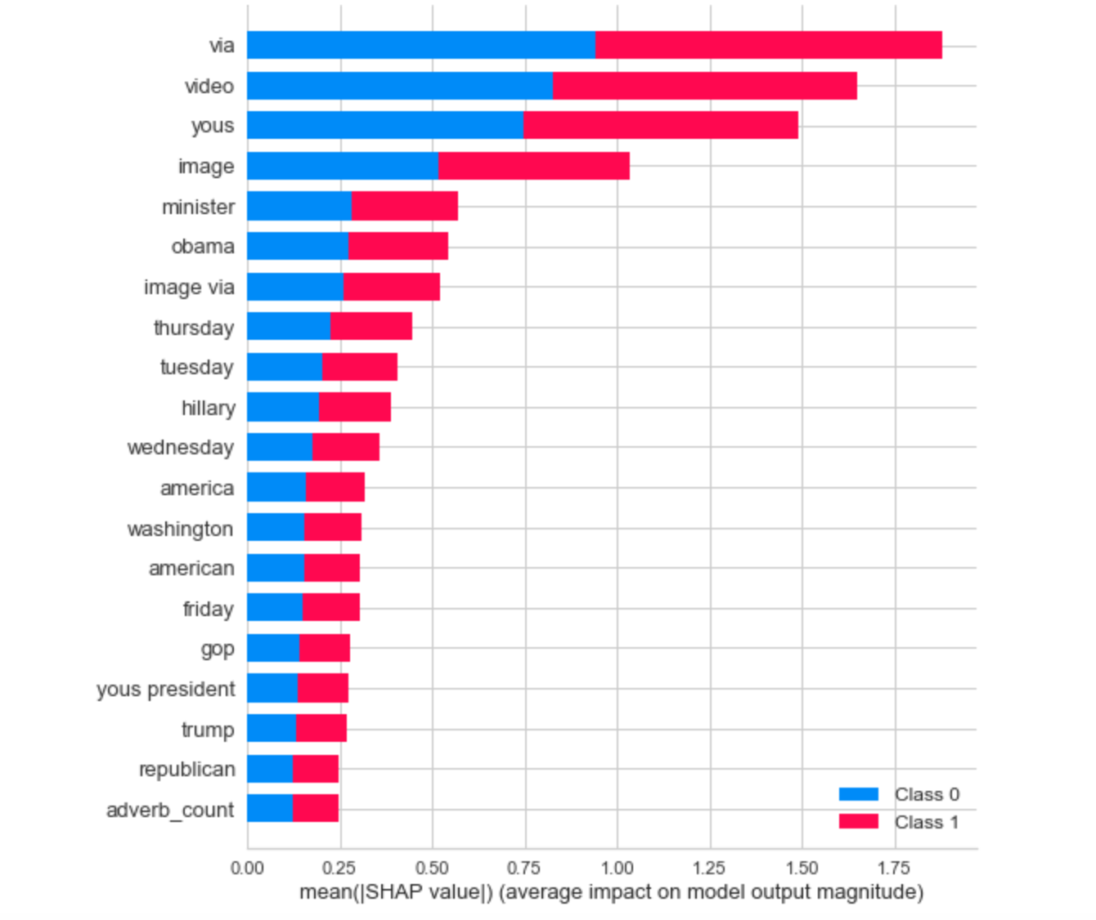
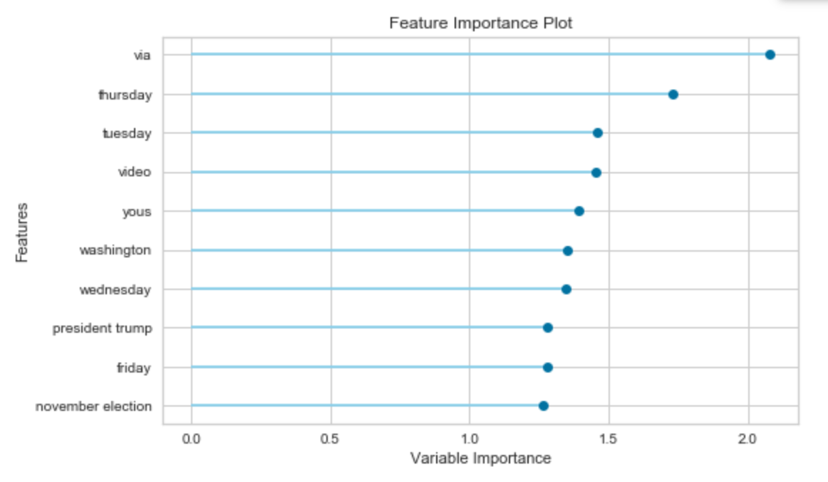
Feature Importance Plot

